Slide 1

Learning Management System
A capstone project: Modern Full-Stack Web Application
Yashika
AET- DotNet Track

Slide 2
Project Overview
Objective:
Build a centralized, secure and scalable Learning Management System where admins manage users and courses, instructors create courses and assignments, and students enroll, learn and submit assignments, easily and securely.
Technology Stack:
.NET Core, Angular , SQL Server
Duration: 10 days

Slide 3
Problem Statement
This project solves the problem of managing learning activities across multiple disconnected tools by providing a centralized Learning Management System. It simplifies user management, course publishing, enrollments, and assignment handling in a single secure platform. Admins gain full control over system operations, instructors can easily manage courses and assignments, and students can access learning content and submit assignments efficiently, improving usability, organization, and security.
Key challenge:
A major challenge was handling cascade delete issues between related tables, which was resolved by configuring restricted delete behavior in EFCore and managing deletions explicitly to maintain data integrity.

Slide 4
Solution & Key Features
🎯 JWT authentication
⚡ Central Management
Secure login using JWT-based authentication with role-based access for Admin, Instructor, and Student feature or capability
Admin-controlled system management including user roles, course publishing, enrollments, and assignments
🔒 Create Courses
📊 Create Assignments
Student access to courses with embedded YouTube learning links and assignment submission functionality
Instructor-driven course content management and assignment creation

Slide 5
Technology Stack
🎯 Backend
⚡ Frontend
Handles business logic, authentication, APIs, and communication with the database using ASP.NET Core.
Provides the user interface using Angular for users to interact with courses, assignments, dashboards, and reports.
🔒 Roles
📊 Database
Defines access control for Admin, Instructor, and Student, ensuring each user can only perform permitted actions.
Stores users, roles, courses, enrollments, assignments, submissions, and progress data securely using SQL Server.

Slide 6
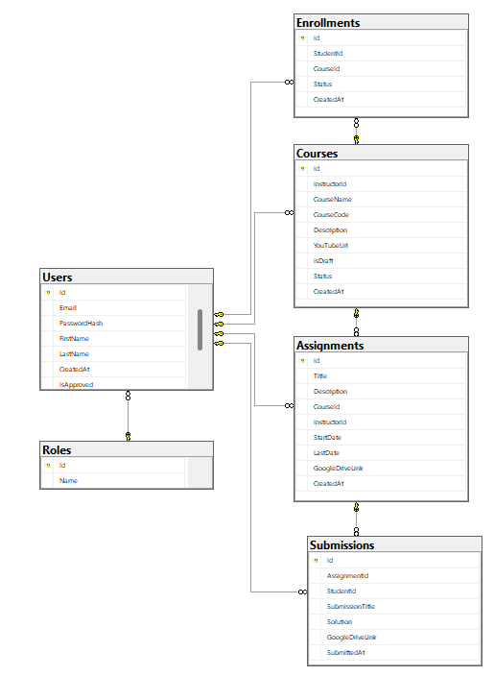
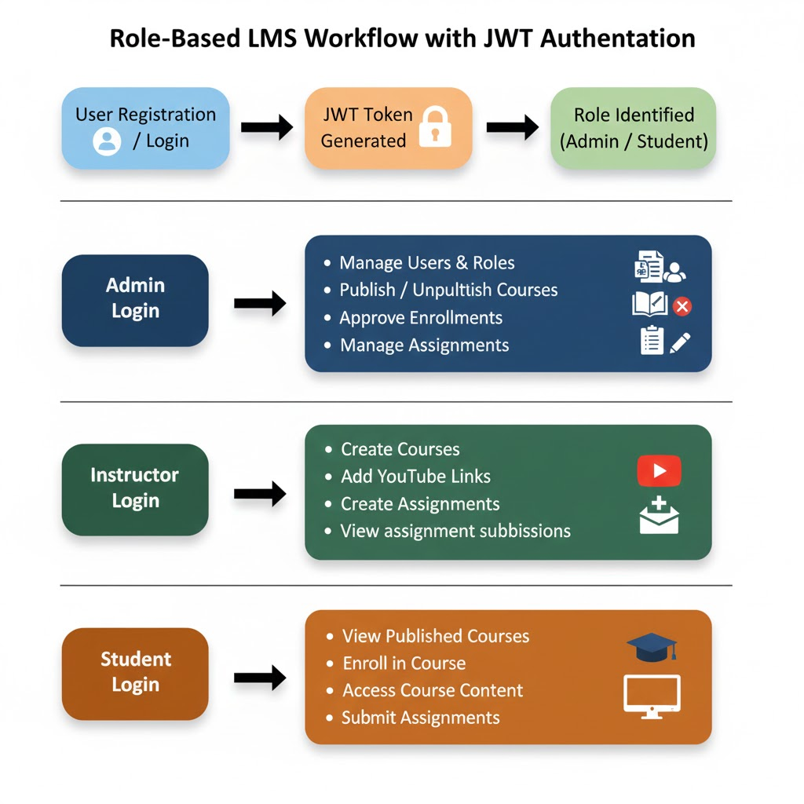
System Architecture

Slide 7
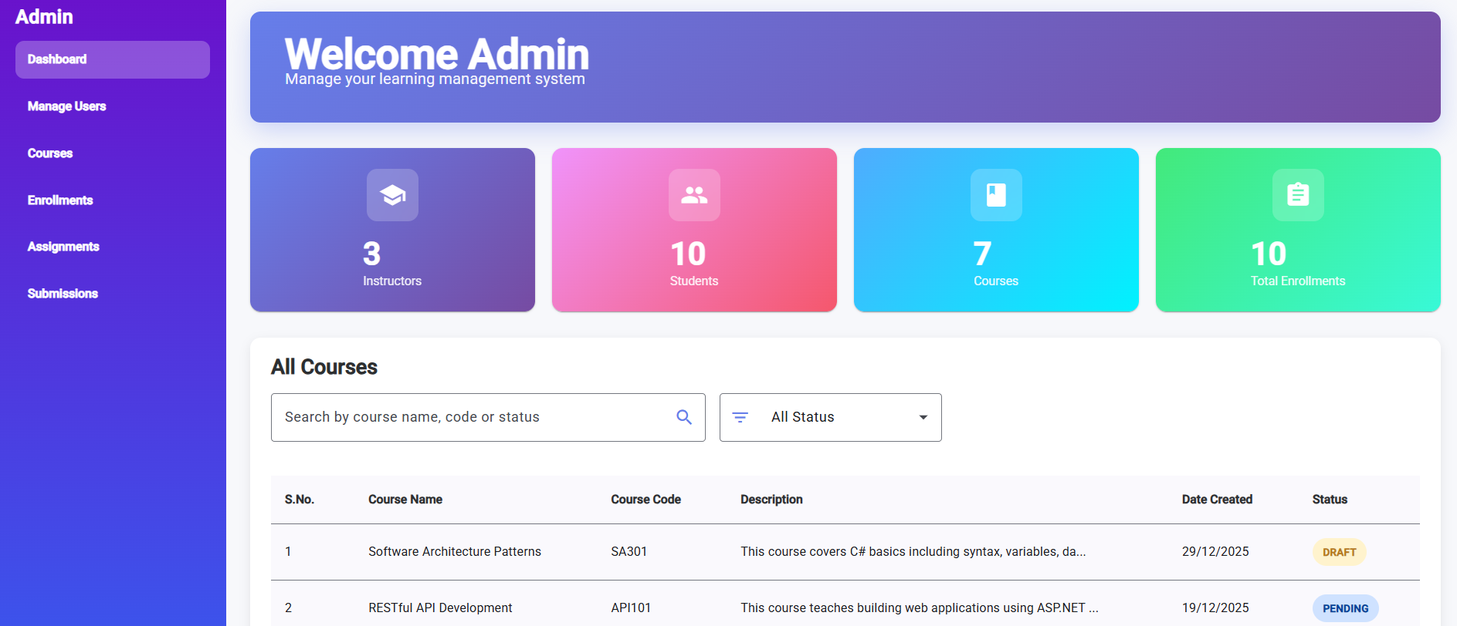
Admin Page

Slide 8
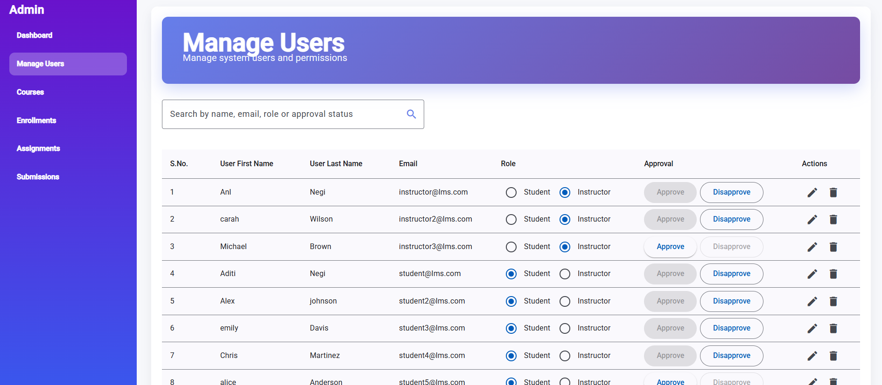
Admin- Manage User

Slide 9
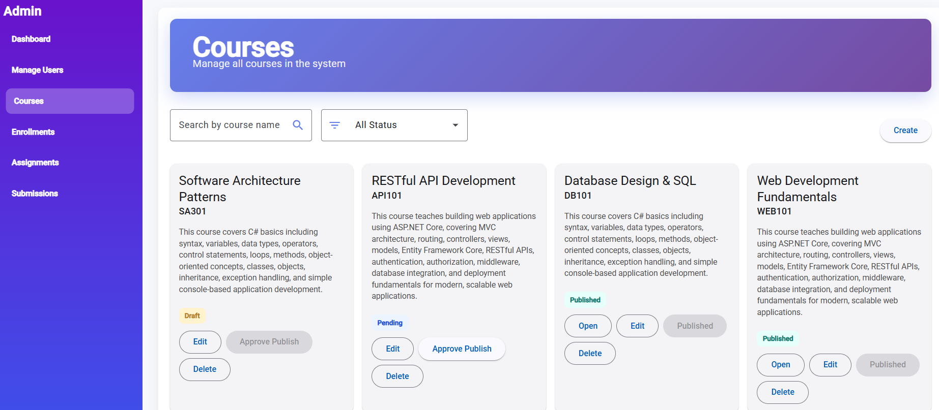
Admin-Courses Page

Slide 10
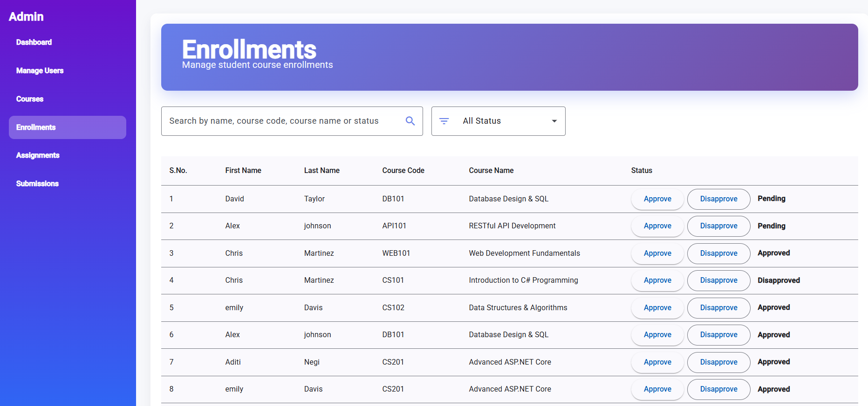
Admin- Enrollments

Slide 11
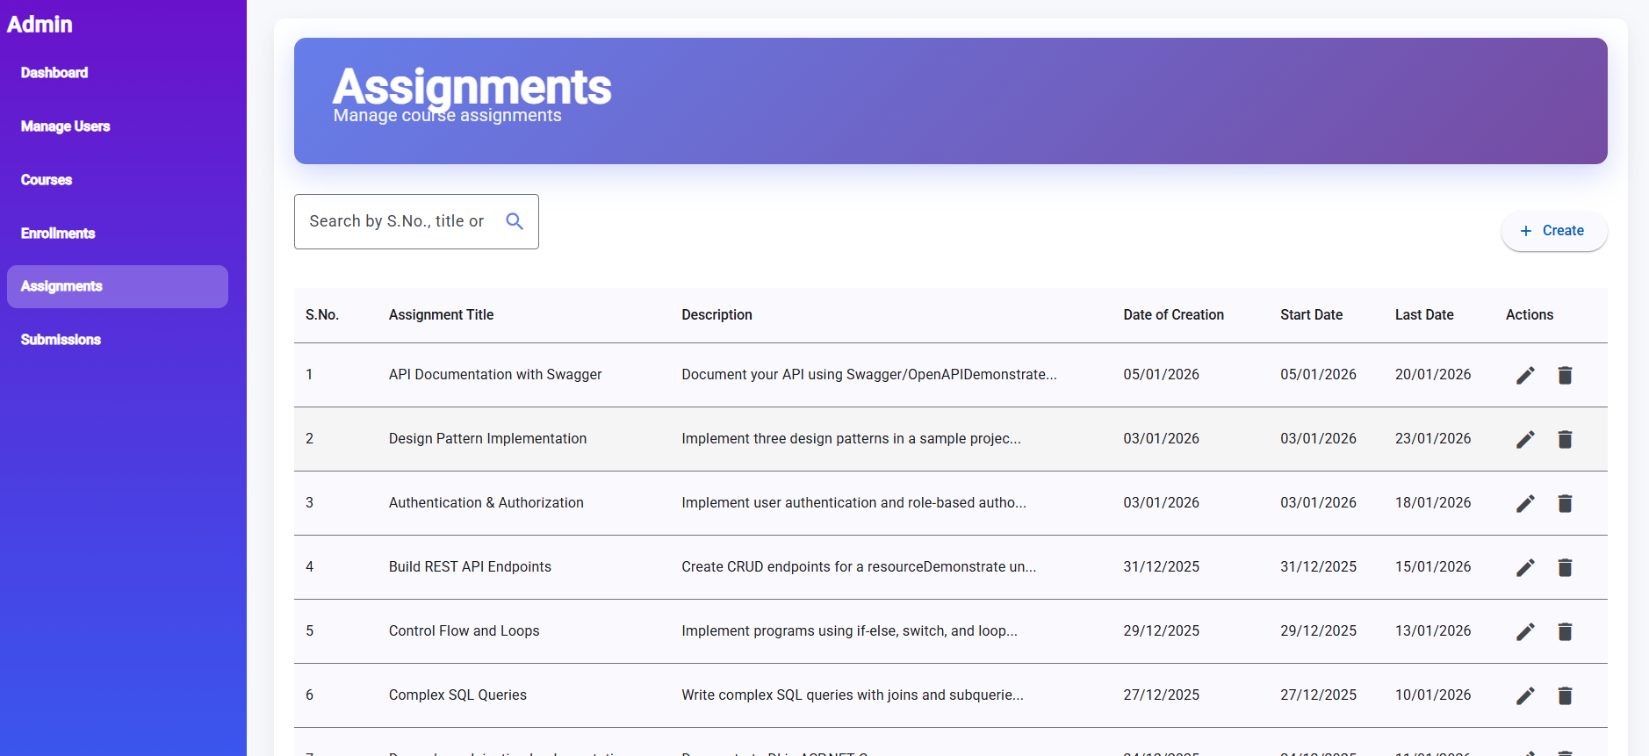
Admin-Assignments

Slide 12
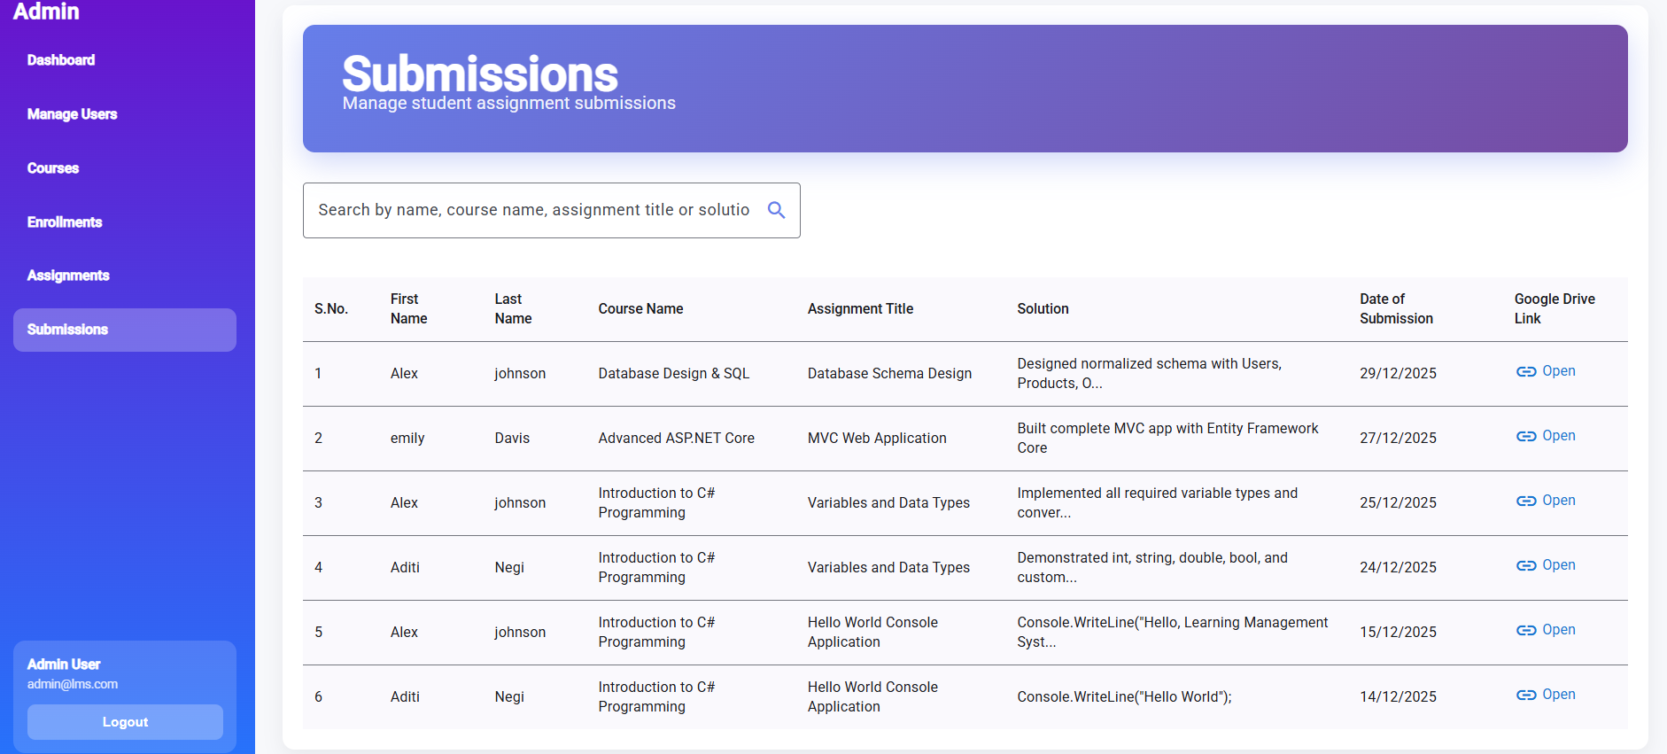
Admin- Submissions

Slide 13
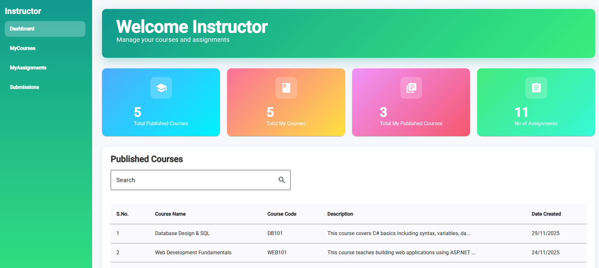
Instructor

Slide 14
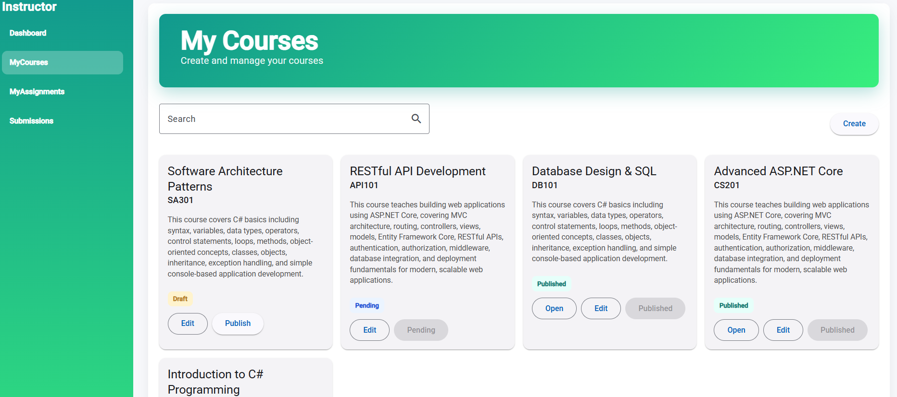
Instructor- MyCourses

Slide 15
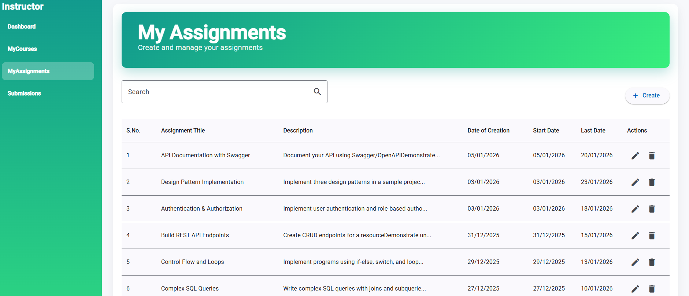
Instructor- MyAsignments

Slide 16
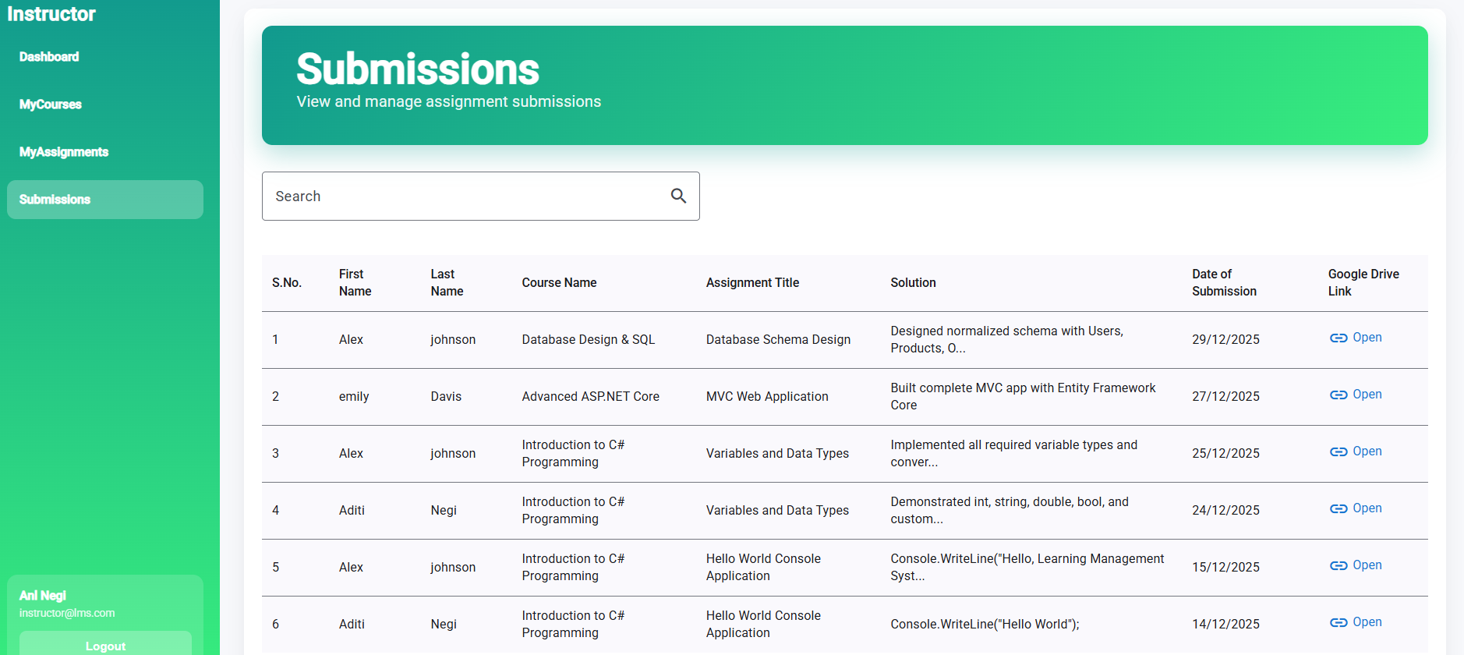
Instructor- Submissions

Slide 17
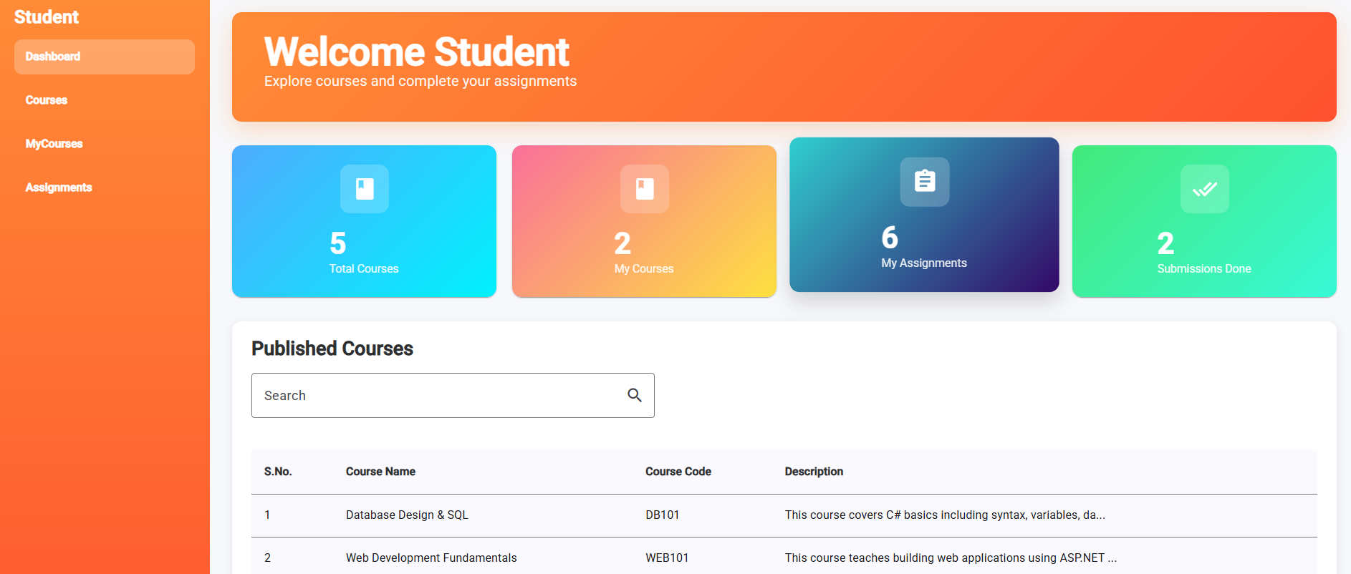
Student

Slide 18
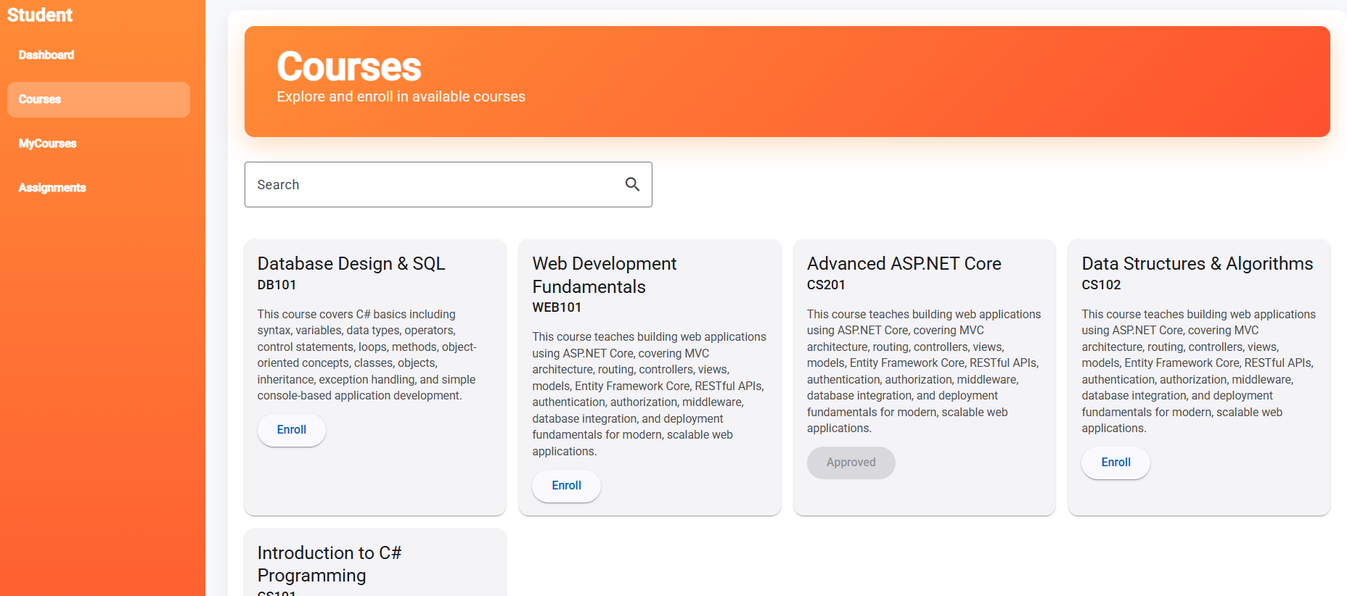
Student- Courses

Slide 19
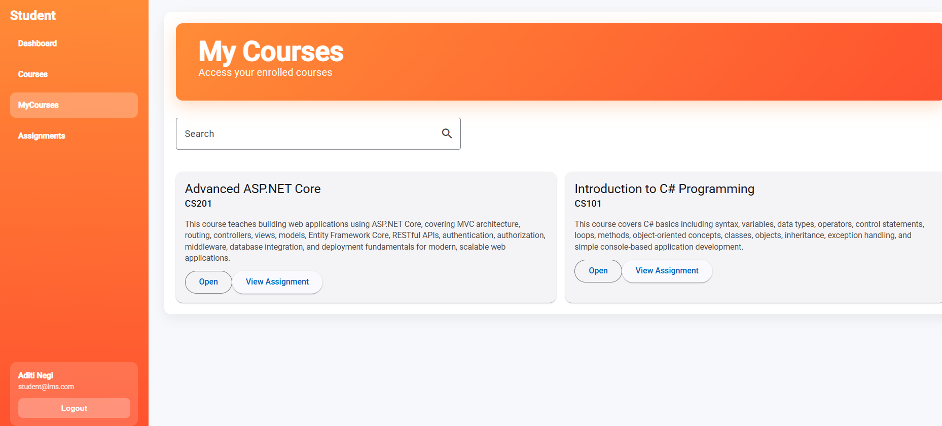
Student- MyCourses

Slide 20
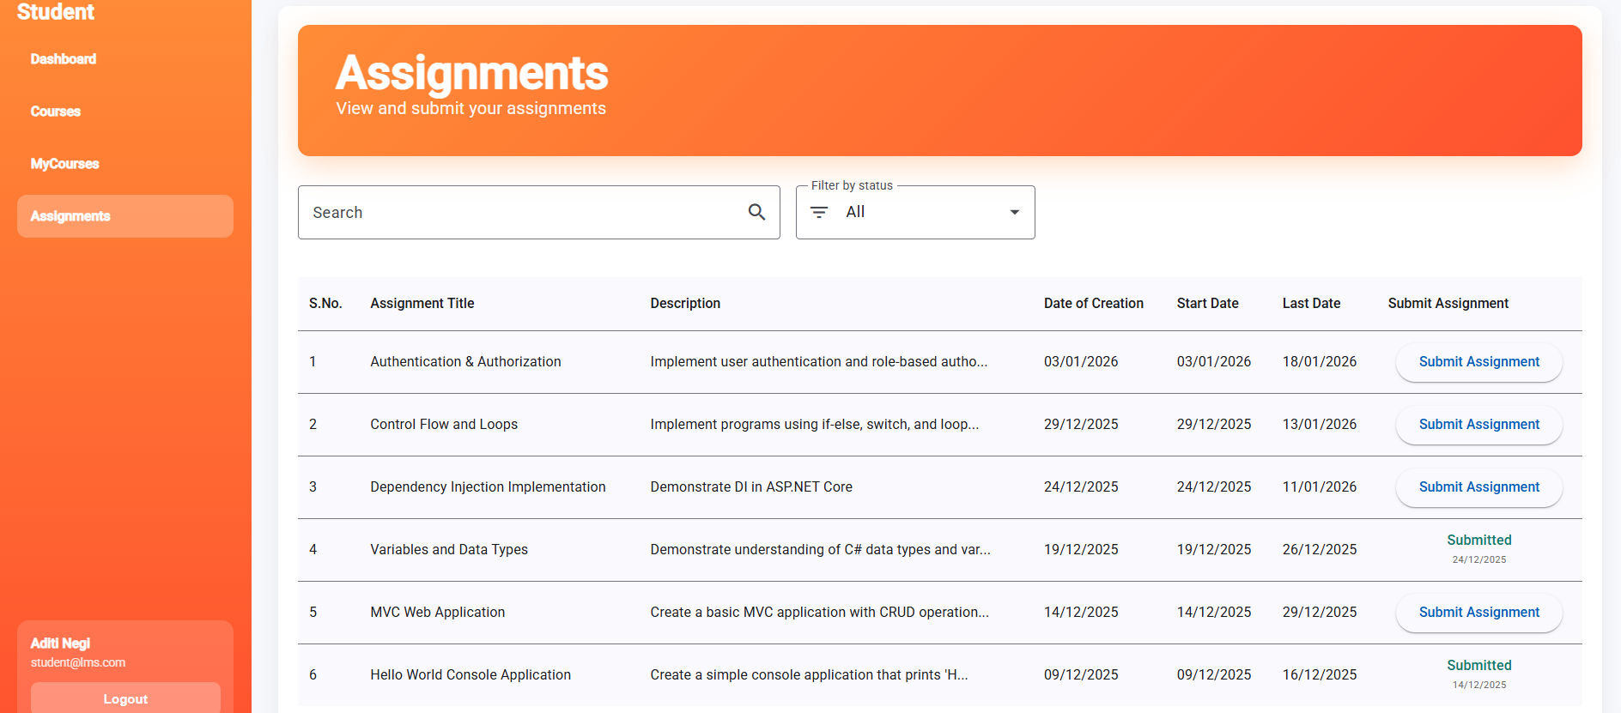
Student- Assignments

Slide 21
Results & Achievements
The Learning Management System was successfully developed as a full-stack application using ASP.NET Core Web API and Angular, implementing secure JWT-based authentication and role-based access for Admin, Instructor, and Student.
Core functionalities such as user management, course creation and publishing, controlled student enrollment, assignment creation, and submission workflows were implemented and tested using xUnit and Postman.
The project follows clean layered architecture with Entity Framework Core, LINQ-based data operations, and modular Angular design, resulting in a stable, maintainable, and real-world LMS solution suitable for academic and corporate training environments.

Slide 22


